Slide 1
MODELING AND PREDICTING MORTALITY: A COMPARATIVE ANALYSIS OF THE CAIRNS BLAKE DOWD AND RENSHAW-HABERMAN MODELS

Slide 2
GROUP 4 MEMBERS
NAME REGISTRATION NUMBER
IAN KARARI SCM221-0013/2020
EMILY NGAHU SCM221-0004/2020
BRIDGES NJIRU SCM221-0051/2020
GRACE MICHELLE SCM221-0005/2020
MARYANNE MUTHONI SCM221-0699/2020
SUPERVISOR
Dr. Matabel Odin

Slide 3
BACKGROUND OF THE STUDY
Mortality Trends refer to patterns and changes observed within a specific population over a specific period of time. When summarizing mortality data, they are observed through life tables.
The Renshaw-Haberman and Cairns Blake Dowd models incorporates cohort effect and are widely recognized with widespread adoption in academic research. Both models are commended due to simplicity and robustness.

Slide 4
STATEMENT OF THE PROBLEM
Accurate mortality rate predictions are vital for life insurance, especially with prevalent downward trends in population mortality rates. In recent years, USA has been experiencing shifts in the rates of mortality. Failure to account for these changes may lead to underestimation of claims therefore calling for the need to have accurate predictions of mortality rates. Cairns Blake Dowd(CBD) and Renshaw-Haberman model being the most used models raises the question as to which of the two gives more accurate predictions.

Slide 5
OBJECTIVES
MAIN OBJECTIVE
Modeling and predicting mortality: a comparative analysis of the Cairns Blake Dowd (CBD) and Renshaw-Haberman models.
To estimate mortality rates using the CBD and Renshaw-Haberman models.
To construct cohort life tables, using mortality rates from the two models.
To compare the mortality trends based on the two models.
SPECIFIC OBJECTIVES

Slide 6
SIGNIFICANCE OF THE STUDY
Life Insurers: Mortality rates are used in longevity risk management which is the risk of policy holders living longer than expected resulting in increased payout amount.
Pension schemes: Predicting mortality rates incorporates longevity considerations and inclusion of longevity risk in mortality projections allows pension schemes to anticipate potential increases in life expectancy and adjust their funding strategies accordingly, ensuring the sustainability of retirement provisions over the long term
Researchers: This study will help address the conflict of which model gives more accurate mortality rate predictions as well as be a foundation to further research in the field.

Slide 7
LITERATURE REVIEW
A study by Cairns et al., (2009) seeked to use formal methods of model selection to rank which of the eight mortality models works best. The study revealed that no specific model stands out as being better than others. However, they observed that different models have different strengths in the way they project mortality.
Renshaw and Haberman (2006) introduced the Age-Period-Cohort (APC) model,also known as the Renshaw Haberman model, by incorporating a cohort effect, whereas Cairns et al. (2006, 2007) elaborated on the implementation of a Generalized Linear Model (GLM) for mortality odd ratios, resulting in the well-known Cairns-Blake-Dowd (CBD) model.
The United States has enjoyed more than a century of nearly uninterrupted declines in mortality and rising longevity(Wharton PPI, 2016). Between 1900 and 2013, life expectancy at birth increased by more than 30 years, with the overall death rate declining steadily at around 1% per year.
There is limited research on mortality predictions based on Kenyan data and most studies consider infant and child mortality with little to no study of adult mortality.

Slide 8
RESEARCH METHODOLOGY

Slide 9
Sub-objective 1; Estimating mortality rates
Table 1: Assumptions of the models
Renshaw-Haberman | Cairns-Blake-Dowd
The age-specific component captures the general shape of the mortality curve across different ages and is assumed to be constant over time. The time-specific component captures the overall level of mortality and its trend over time and is assumed to follow a random walk with drift. That people born in the same generation will experience the same trend in mortality. | The age effects are simple and allow different improvements at different ages at different times. The time-specific component captures the overall level of mortality and its trend over time and is assumed to follow a random walk with drift. Accounts for cohort effects, which are the influences of shared experiences and characteristics of people born in the same year or period. The model assumes that, at older ages say from 50 ,the mortality behaves more or less linear

Slide 10
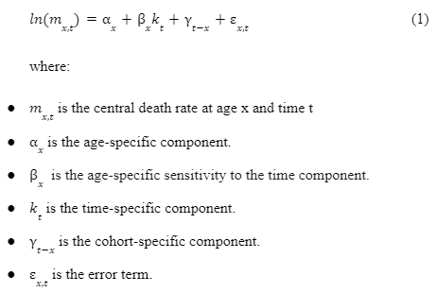
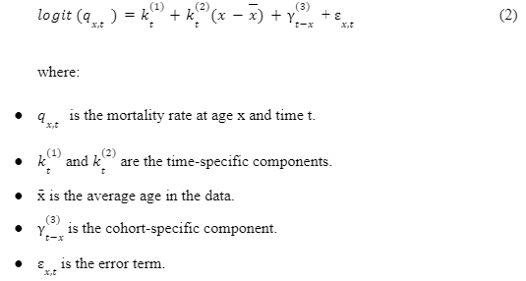
Sub-objective 1; Estimating mortality rates cont.
Table 2: Model Formulas
Renshaw-Habermann
Cairns-Blake-Dowd

Slide 11
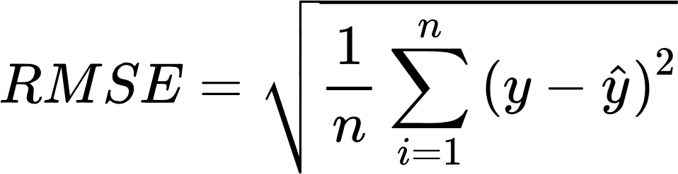

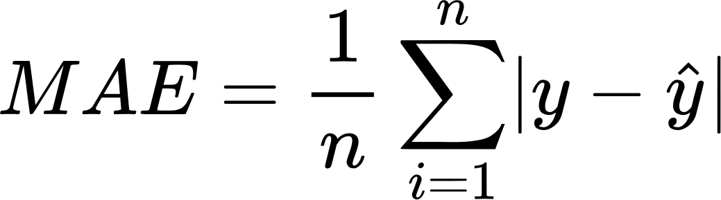

Sub-objective 1;Estimating mortality rates cont.
Performance evaluation of the models

Slide 12
Sub-objective 2; Construction of cohort life tables
Cohort life tables is a statistical tool center on analyzing data for groups of individuals born during the same time period and then following these cohorts throughout their lifetimes.
These tables track the experiences of a specific birth cohort over their entire lifetimes providing a more accurate reflection of mortality trends since they account for changes in mortality rates that occur over time.
Assumptions
The only form of exit is by death.
Assumes a closed cohort where births, immigration, and emigration are not considered.
Individuals within the cohort are assumed to have the same mortality characteristics and variations within the cohort are not explicitly considered.

Slide 13
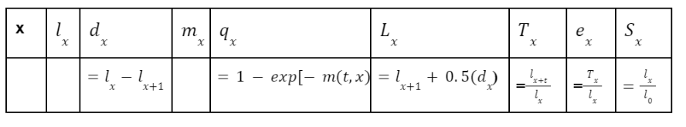
Sub-objective 2; Construction of cohort life tables cont.
Table 3: Life table Format

Slide 14
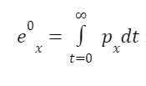
Sub-objective 3; To compare the mortality trends based on the two models
Mortality trends:
q_x :Probability of dying within the next t years plotted against time
S_x : proportion of individuals that survive to a certain age plotted against time
e_x : Life expectancy plotted against time
Longevity risk :Risk that an individual lives longer than expected -Observed as the summary of life expectancies at age 60 against time

Slide 15
RESULTS

Slide 16
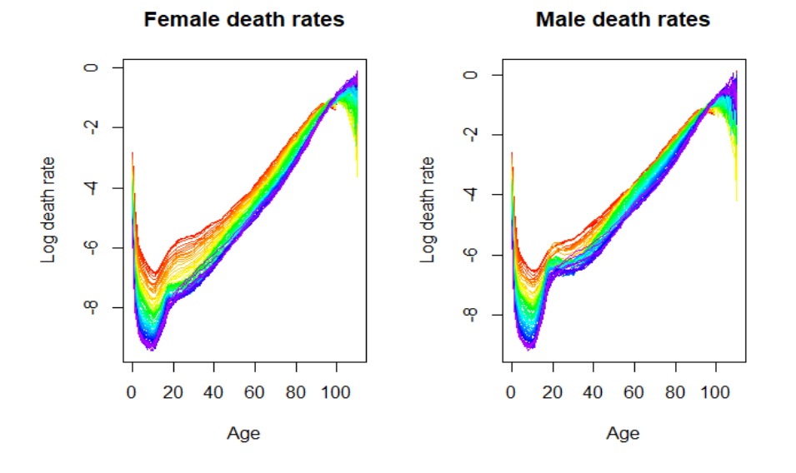
Exploratory data analysis
Figure 1: Death rates against age
The data used for this study was secondary data for the United States of America from the Human Mortality Database for the years 1933 to 2021. The data included yearly information about the mortality rates, exposures, number of deaths and number of births for both males and females.

Slide 17
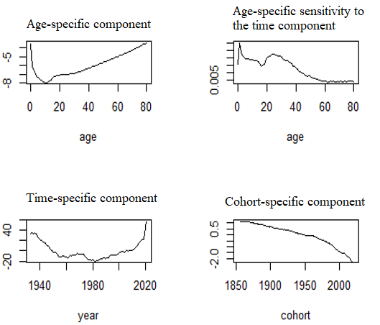
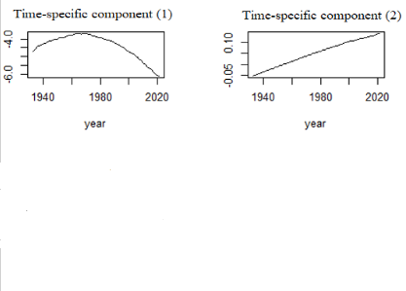
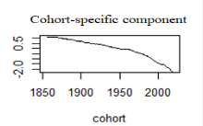
Sub-objective 1 Female Parameters
Figure 2: Renshaw-Haberman parameters
Figure 3: Cairns-Blake-Dowd parameters

Slide 18
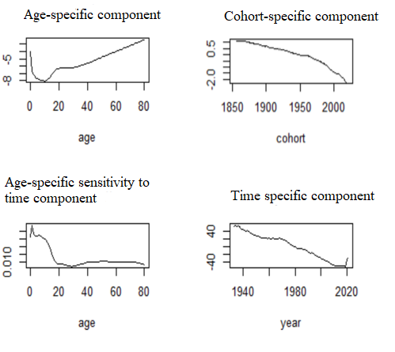
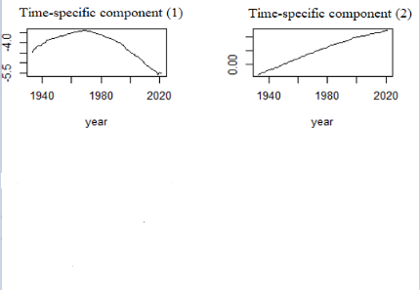
Sub-objective 1 Male Parameters
Figure 4:Renshaw-Habermann Parameters
Figure 5:Cairns-Blake-Dowd Parameters

Slide 19
Goodness of fit
Table 4: RMSE Estimates
Table 5: MAE Estimates
Gender | Cohort | RH | CBD
Female | 1981 | 0.0009505 | 0.0015531
 | 2002 | 0.0004488 | 0.0013369
Male | 1981 | 0.0002668 | 0.0019189
 | 2002 | 0.0002535 | 0.0016520
Gender | Cohort | RH | CBD
Female | 1981 | 0.01507 | 0.1951
 | 2002 | 0.008928 | 0.3041
Male | 1981 | 0.01507 | 0.1962
 | 2002 | 0.008928 | 0.2846

Slide 20
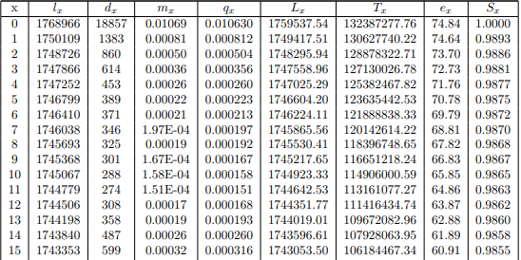
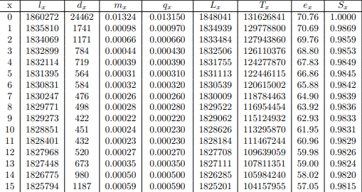
Sub-objective 2; To construct cohort life tables,
Table 6: 1981 Female Life Table Generated using Mortality Rates of RH
Table 7: 1981 Male Life Table Generated using Mortality Rates of RH

Slide 21
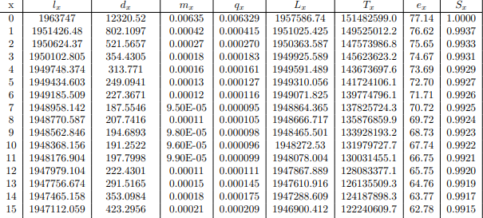
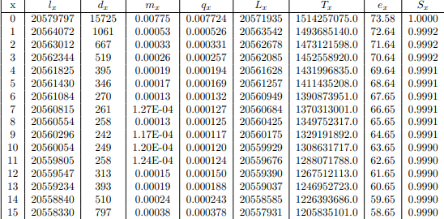
Sub-objective 2; RH 2002 Cohort Life Tables
Table 8:2002 Female Life Table Generated using Mortality Rates of RH
Table 9:2002 Male Life Table Generated using Mortality Rates of RH

Slide 22
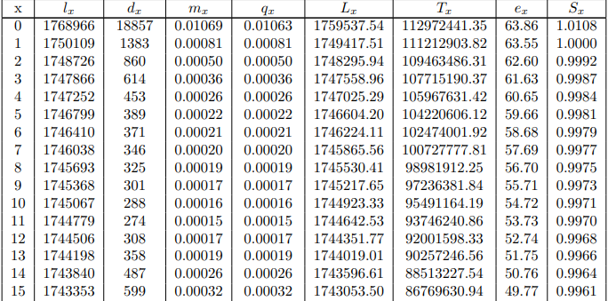
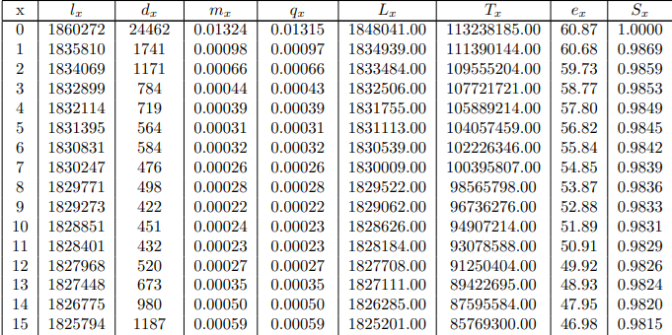
Sub-objective 2;CBD 1981 Cohort Life Tables
Table 10 : 1981 Female Life Table Generated using Mortality Rates of CBD
Table 11 : 1981 Male Life Table Generated using Mortality Rates of CBD

Slide 23
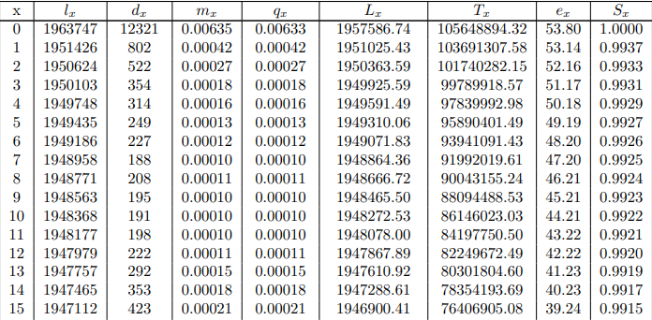
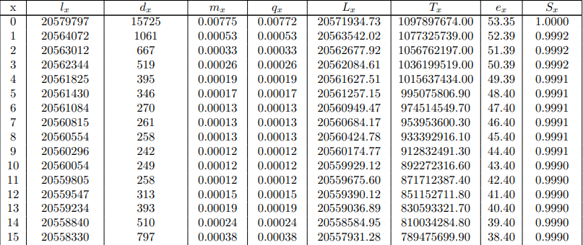
Sub-objective 2; CBD 2002 Cohort Life Tables
Table 12 : 2002 Female Life Table Generated using Mortality Rates of CBD
Table 13 :2002 Female Life Table Generated using Mortality Rates of CBD

Slide 24
Table 14 : Estimated against Expected Life Expectancy
 | Year | Models
Gender |  | RH | CBD | Expected life expectancy
Female | 1981 | 74.84 | 63.86 | 77.8
 | 2002 | 77.14 | 53.80 | 79.6
Male | 1981 | 70.76 | 60.87 | 70.4
 | 2002 | 73.58 | 53.35 | 74.4

Slide 25
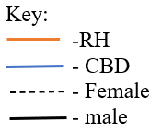
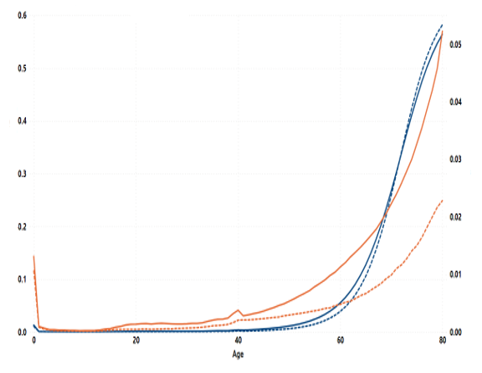
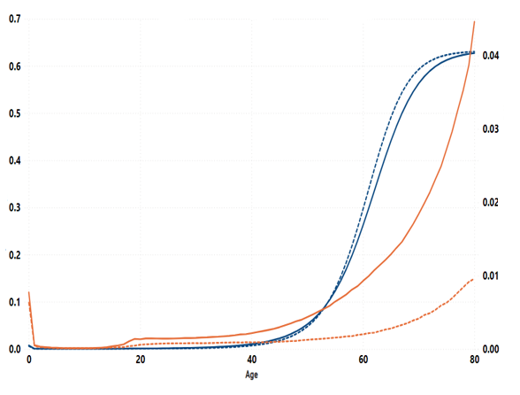
Sub-objective 3 Probability of dying within the next t years
Figure 8: Probability of dying within the next t years for I981 cohort
Figure 9: Probability of dying within the next t years for I981 cohort

Slide 26
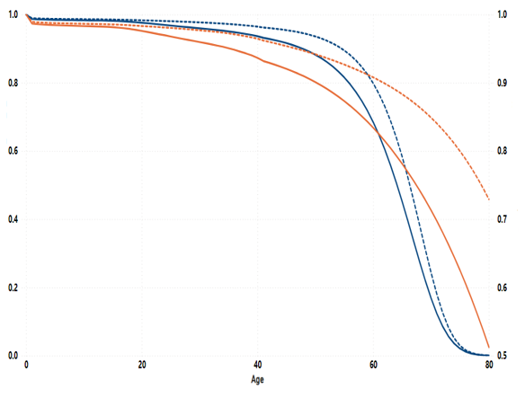
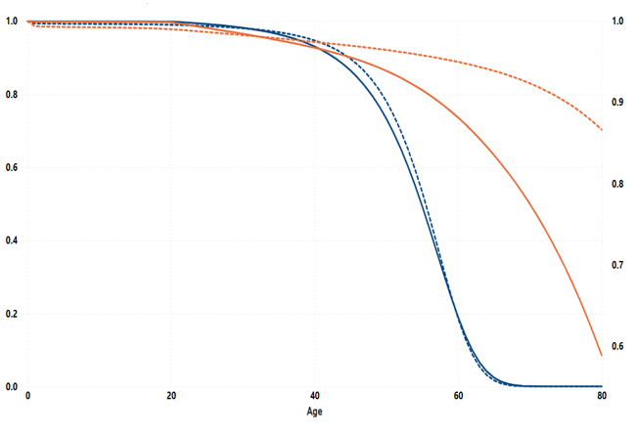
Sub-objective 3 Proportion of individuals that survive to age x
Figure 6: Probability of surviving within the next t years for I981 cohort
Figure 7: Probability of Surviving within the next t years for 2002 cohort

Slide 27
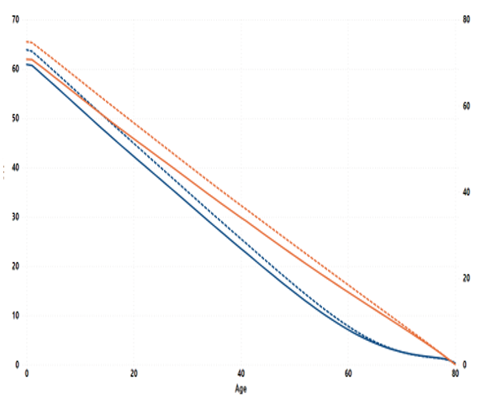
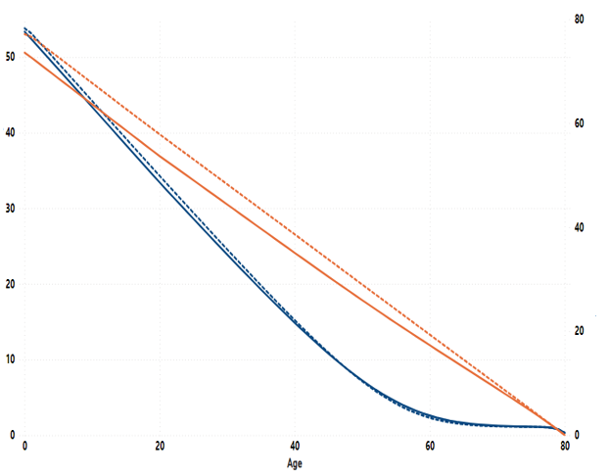
Sub-objective 3 Life expectancy
Figure 10: Life Expectancy for I981 cohort
Figure 11: Life Expectancy for 2002 cohort

Slide 28
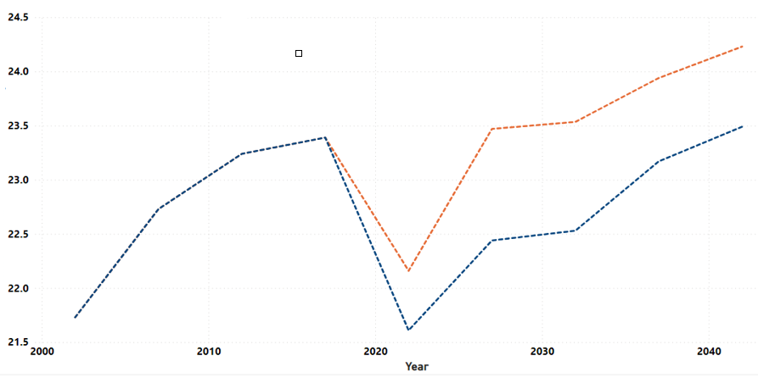
Sub-objective 3 Longevity Risk
Figure 12: Summary of life expectancy at age 60

Slide 29
SUMMARY AND CONCLUSIONS
From objective one; the Renshaw Haberman (RH) model demonstrated superior predictive accuracy over the Cairns Blake Dowd (CBD) model.
From objective two; the life tables helped obtain and extract mortality trends, with RH giving higher life expectancies which are closer to the expected.
From objective three; both models indicated females generally had lower mortality risks and higher survival rates compared to males. However, under the CBD model,there is a very slight distinction between the male and female mortality as they age suggesting a simplified representation of gender-specific mortality patterns . The increase in life expectancy suggested people are living longer, increasing longevity risk.
In conclusion, RH demonstrated superior predictive capability over CBD, its accuracy being attributed to its age-specific sensitivity to the time component. This unlike CBD's declining accuracy over longer forecast periods, evident in the 2002 cohort. Hence, RH is the better model to estimate and forecast US mortality.

Slide 30
REFERENCES
Alijean, M. A., & Narsoo, J. (2018a). Evaluation of the kou-modified Lee-Carter model in mortality forecasting: Evidence from French male mortality data. Risks, 6(4), 123. https://doi.org/10.3390/risks6040123
Cairns, A. J. G., Blake, D., Dowd, K., Coughlan, G. D., Epstein, D., Ong, A., & Balevich, I. (2009). A Quantitative Comparison of Stochastic Mortality Models Using Data From England and Wales and the United States. North American Actuarial Journal, 13(1), 1–35. https://doi.org/10.1080/10920277.2009.10597538
Cairns, A.J.G., Blake, D., Dowd, K., Coughlan, G., Epstein, D., and Khallaf-Allah, M. (2008) “The plausibility of mortality density forecasts: an analysis of six stochastic mortality models”, Working paper, Heriot-Watt University, and Pensions Institute Discussion Paper PI-0801.
Wharton PPI. (2016, June 27). Penn Wharton Budget Model. Penn Wharton Budget Model. https://budgetmodel.wharton.upenn.edu/issues/2016/1/25/mortality-in-the-united-states-past-present-and-future

Slide 31
THANKYOU

